Slide 1
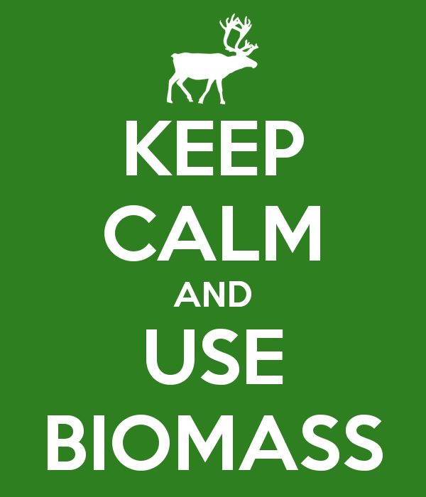
Biomass Resources
By Philip S., Dan M., Jackson G., and Nate D. and that random black guy

Slide 2
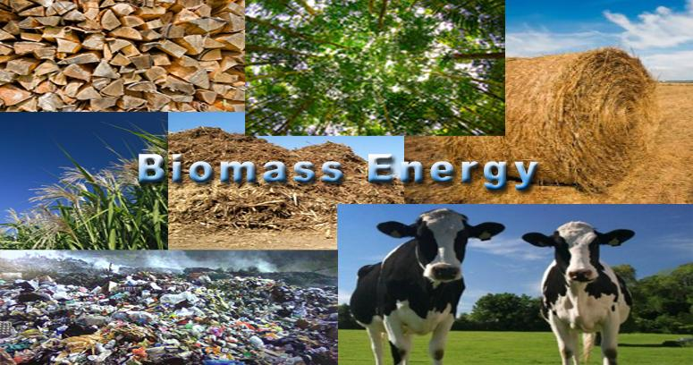
General Overview
Biomass resources are any plant derived organic matter that is available on a renewable basis.
Biomass resources are also known as “feedstock.”

Slide 3
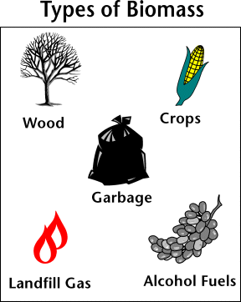
Types of Biomass Resources
“-Biomass feedstocks include dedicated energy crops, agricultural crops, forestry residues, aquatic crops, biomass processing residues, municipal waste, and animal waste.”

Slide 4
Dedicated energy crops
America’s most produced energy crops is Maize.
There are two types of energy crops
Natural sugar energy crops: Basically any plant can be a natural sugar energy crop because all plants have sugar.
Bio oils:A fuel that use ethanol or wood to be composed into a liquid for transportation.

Slide 5
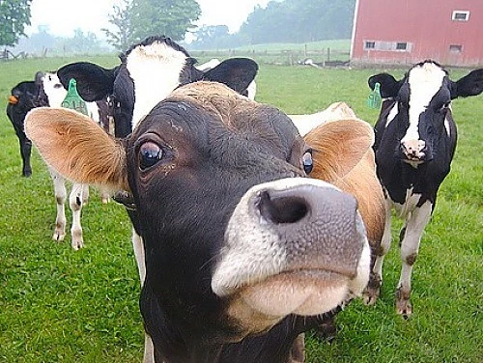
Animal Waste
Manure: properly processed, can provide reliable/clean source of energy
So much of it
Renewable (as long as there are animals)
One cow, in one year, can produce enough manure to be equivalent to 53 gallons of gasoline.

Slide 6
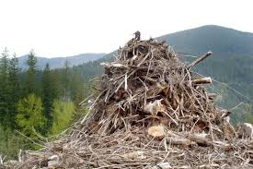
Forestry residues
Forestry Residues are
Residues from harvest operations that are left in the forest after stem wood removal, such as branches, foliage, roots, etc.
Complementary fellings which describe the difference between the maximum sustainable harvest level and the actual harvest needed to satisfy round wood demand.

Slide 7
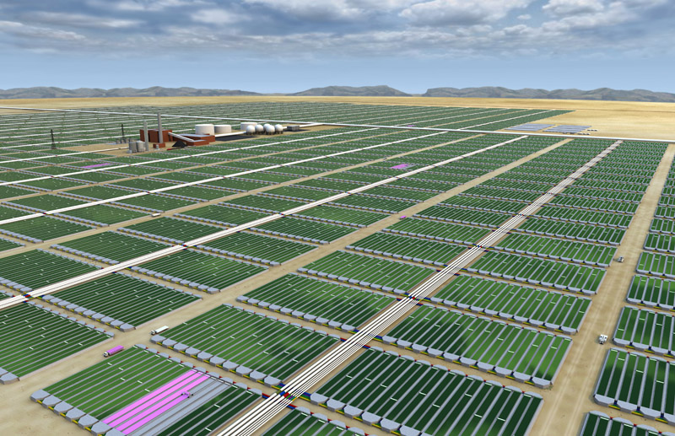
Aquatic Crops/Algae
Does not need clean water to thrive
Abundant
Suspended in water, and in that water, it can grow several times its original size a day.
Most of the algae is lipids, or natural oils.
We extract those oils for biodiesel and bio jet fuel.

Slide 8
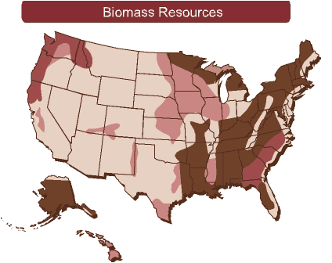
Uses of Biomass Resources
Biomass resources are used to produce fuels that in turn produce energy.
Biomass resources can be converted into liquid fuels, such as biodiesel and ethanol. In turn, these fuels can be used for a variety of purposes.
Combustion of biomass (like wood) can be used for heating water and cooking.
Concentration of Biomass Resources across the US.
(darker = more biomass resources)

Slide 9
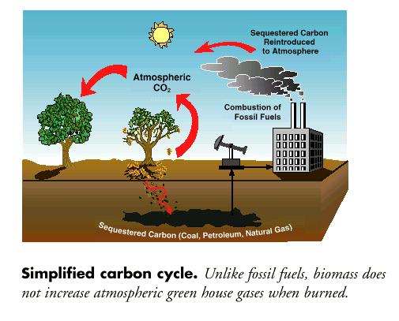
Renewable and Sustainable
The carbon in biomass is part of the natural carbon cycle; makes biomass renewable.
Almost unlimited supply of biomass.
Sustainable, biomass is not a limited resource. Created by growing crops, using dead trees, etc. (Animal poo!)
Measures in place to make sure that no one resource is overused.

Slide 11
Works Cited
http://energy.gov/eere/energybasics/articles/biomass-resource-basics
http://teeic.indianaffairs.gov/er/biomass/restech/uses/howuse/index.htm
http://blogs.ei.columbia.edu/2011/08/18/is-biomass-really-renewable/
http://www.cnn.com/2008/WORLD/asiapcf/01/07/eco.about.manure/index.html?iref=allsearch#cnnSTCText

Slide 12
Works Cited continued
Biomassenergycentre. N.p., n.d. Web. 22 Nov. 2015. <http://www.biomassenergycentre.org.uk/portal/page?_pageid=75,17301&_dad=portal&_schema=PORTAL>
energy independence. N.p., n.d. Web. 22 Nov. 2015. <http://www.americanenergyindependence.com/energycrops.aspx>
NREL. N.p., n.d. Web. 22 Nov. 2015. <http://www.nrel.gov/learning/re_biofuels.html>.
Roberts, David. N.p., 6 Feb. 2006. Web. 22 Nov. 2015. <http://grist.org/article/biofuel-some-numbers.
http://biofuelstp.eu/forest.html

